Slide 1
K-NN Algorithm
K-Nearest Neighbour is one of the simplest Machine Learning algorithms based on Supervised Learning technique.
K-NN algorithm assumes the similarity between the new case/data and available cases and put the new case into the category that is most similar to the available categories.
K-NN algorithm stores all the available data and classifies a new data point based on the similarity. This means when new data appears then it can be easily classified into a well suite category by using K- NN algorithm.
K-NN algorithm can be used for Regression as well as for Classification but mostly it is used for the Classification problems.
K-NN is a non-parametric algorithm, which means it does not make any assumption on underlying data.
It is also called a lazy learner algorithm because it does not learn from the training set immediately instead it stores the dataset and at the time of classification, it performs an action on the dataset.
KNN algorithm at the training phase just stores the dataset and when it gets new data, then it classifies that data into a category that is much similar to the new data.

Slide 2
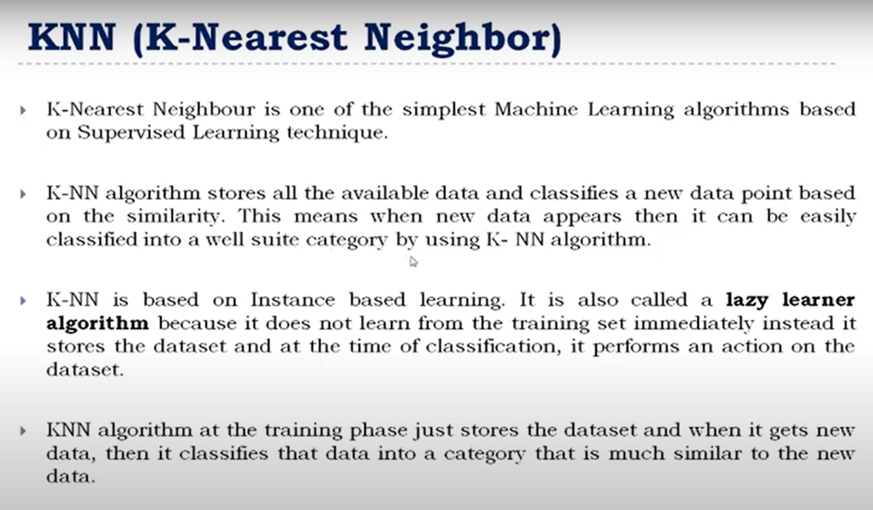
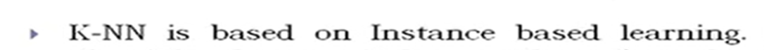
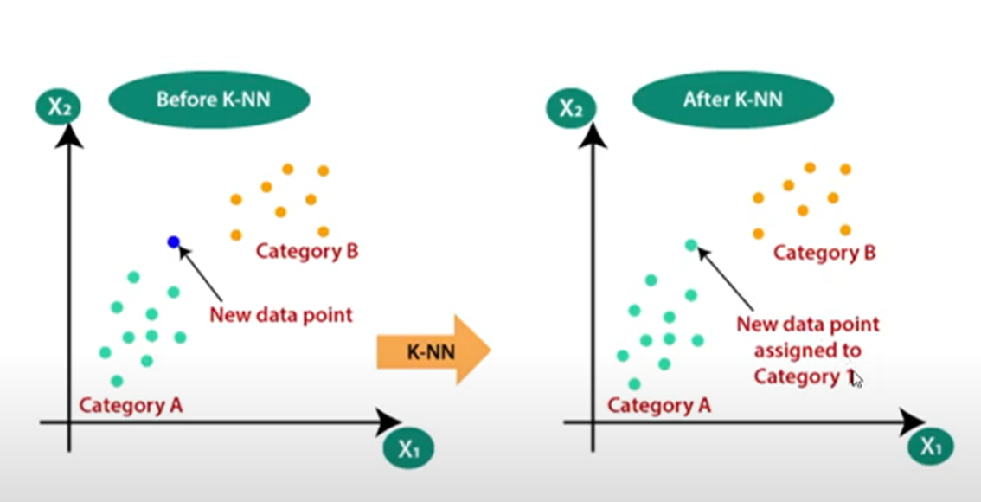

Slide 3
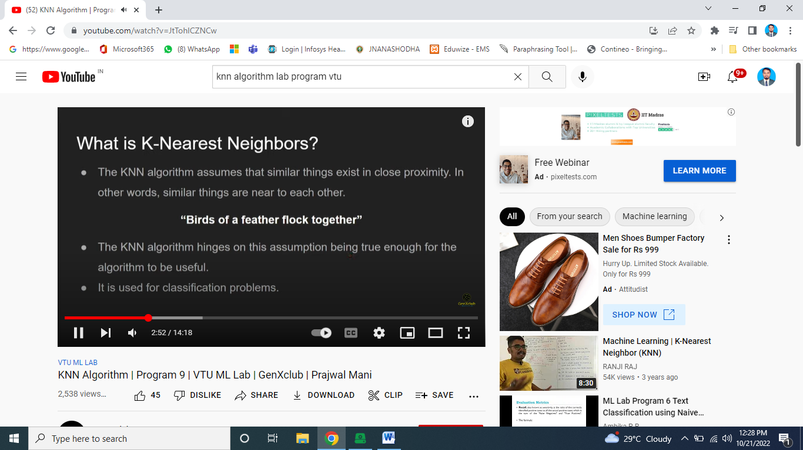
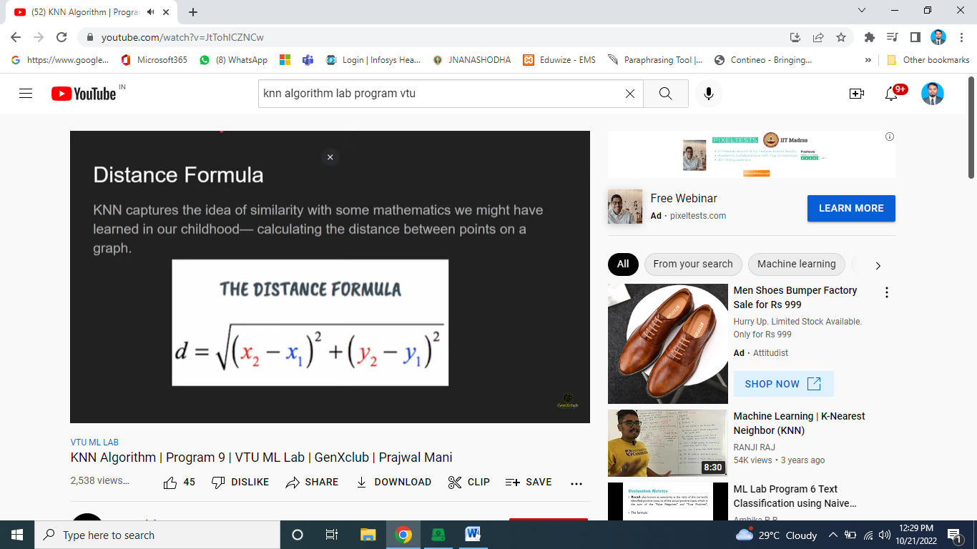

Slide 4
Sample Paper | Acid Durability | Strength | Quality
Paper_1 | 7 | 7 | Bad
Paper_2 | 7 | 4 | Bad
Paper_3 | 3 | 4 | Good
Paeper_4 | 1 | 4 | Good
Problem: Apply KNN classification on the following dataset and predict the quality of paper_5 having Acid Durability = 3 and Strength = 7 for K= 3 (Nearest Neighbor).
Solution:
The data from a survey and objective testing with two attributes (Acid durability and Strength) can be used to classify whether the quality of the sample paper is good or bad.
Step1: Number of parameters K = Number of nearest neighbors. Therefore, from the given data K = 3

Slide 5
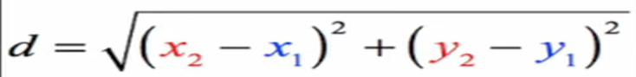
Step2: Calculate the distance between the query instance and all the training samples.
Here query instance is (3,7) and calculates the distance by using the Euclidean Distance formula. The below table shows the Euclidean Distance for every paper from the query instance (3, 7):

Slide 6
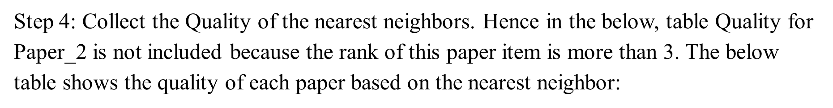
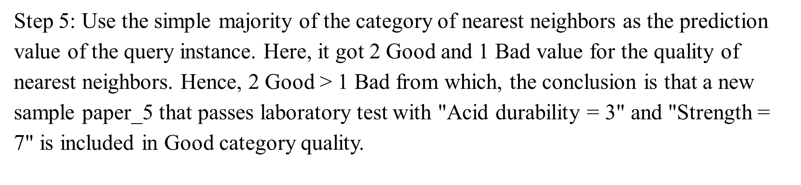
Step 3: Sort the distance and determine the nearest neighbors based on minimum distance The below table shows the sorted distance and according to that nearest neighbor is decided for each paper:

Slide 7
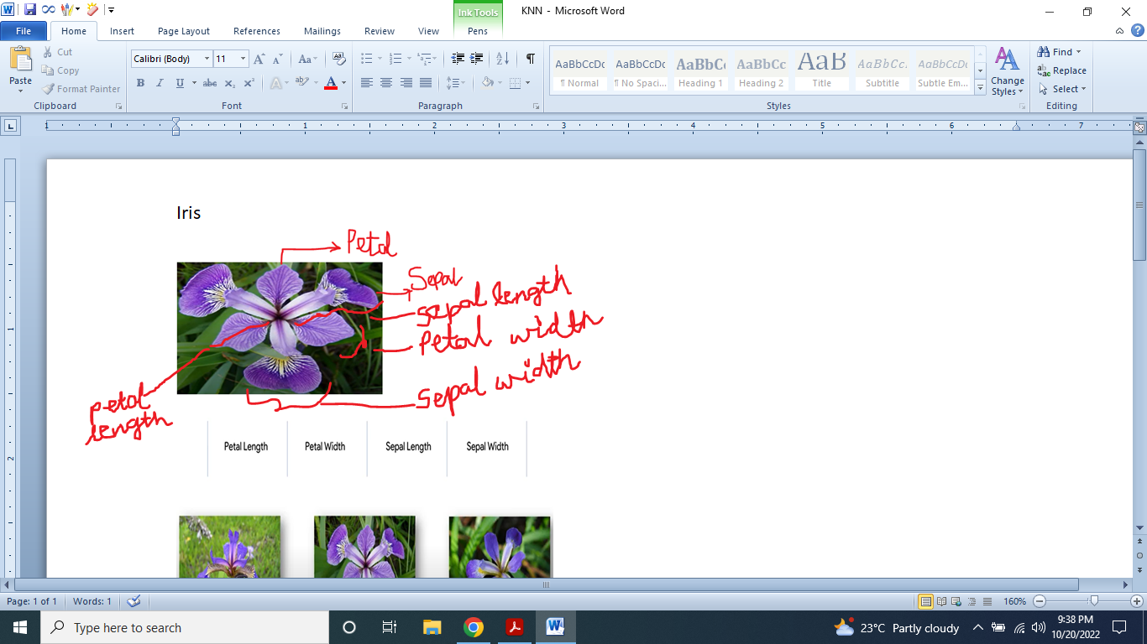
Program 8: Write a program to implement k-Nearest Neighbor algorithm to classify the iris data set. Print both correct and wrong predictions
As per the question we have to use iris Data set
Iris is a flowering plant.
The characteristics of the iris plant such as petal length, petal width, sepal length, sepal width are used in the data set.
These four features of the plant form the columns of the data set

Slide 8
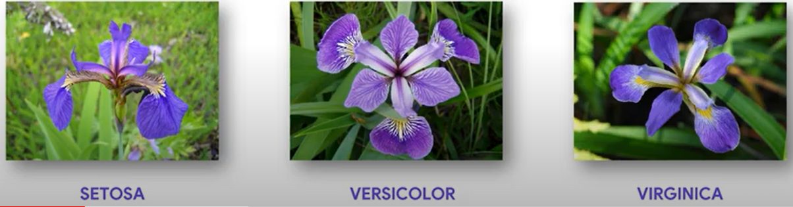
Let us look at the three types of Iris plasnts i.e Setosa, Versicolour, Virginica.
•Based on the values of the features like petal length, petal width, sepal length, sepal width the each row in the data set is classified according to its type.
•The right most column indicates the type of flower.

Slide 9
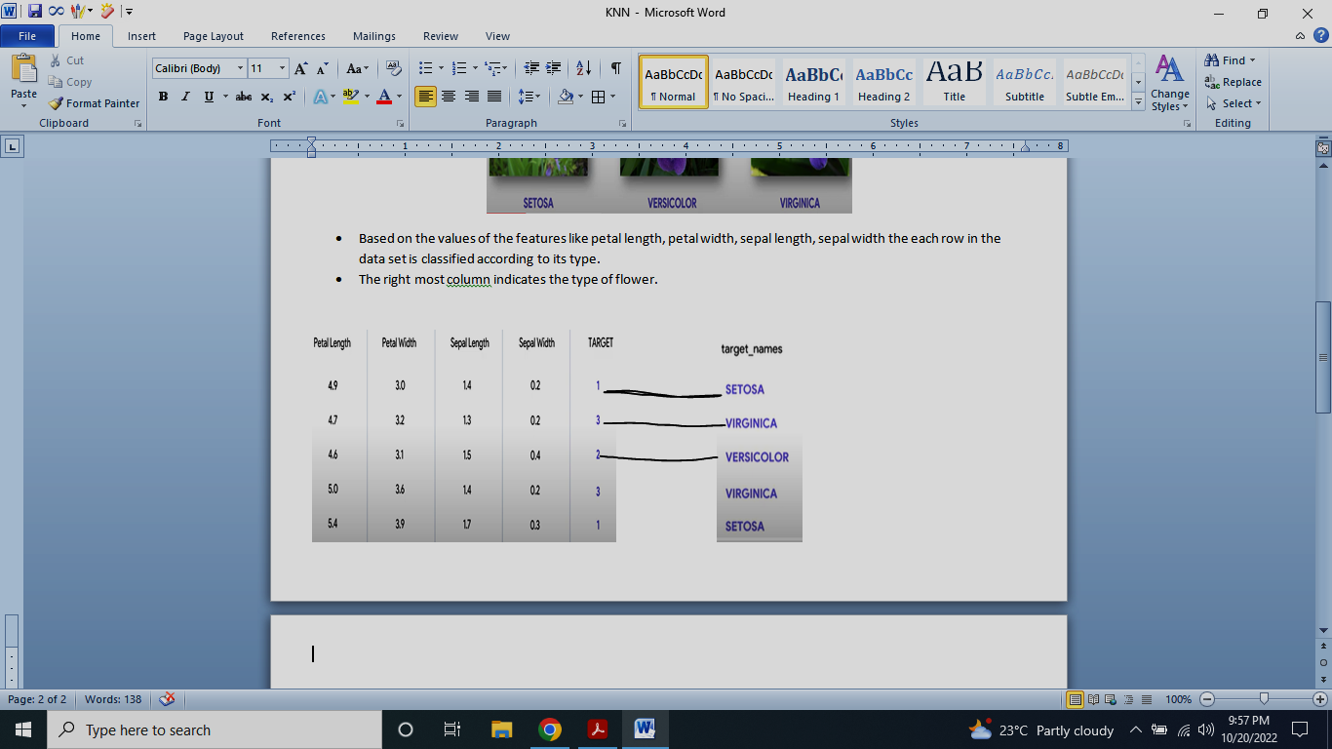
The target number values can be mapped to target names here 1 is setosa, 2 is versicolor, 3 is virginica
The iris dataset is provided by scikit learn.

Slide 10
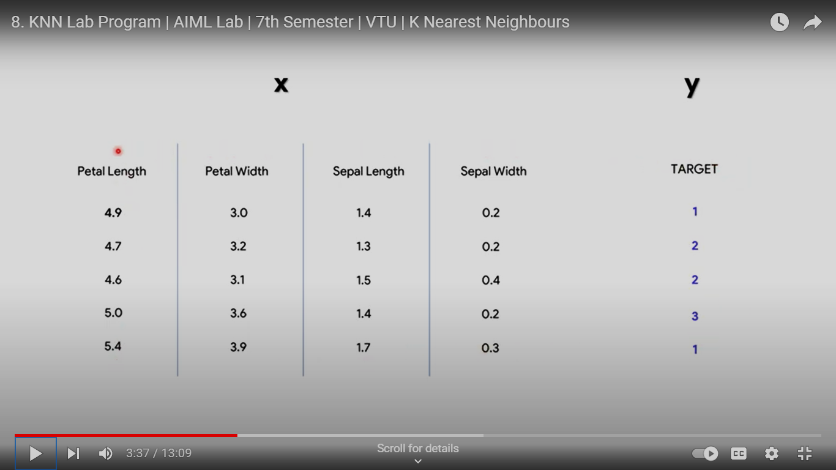
Let us start writing the program now
The features column is called as x and the target column is called as Y
More than the majority of the rows can be used for training the model some of the rows can be used for testing the model

Slide 11
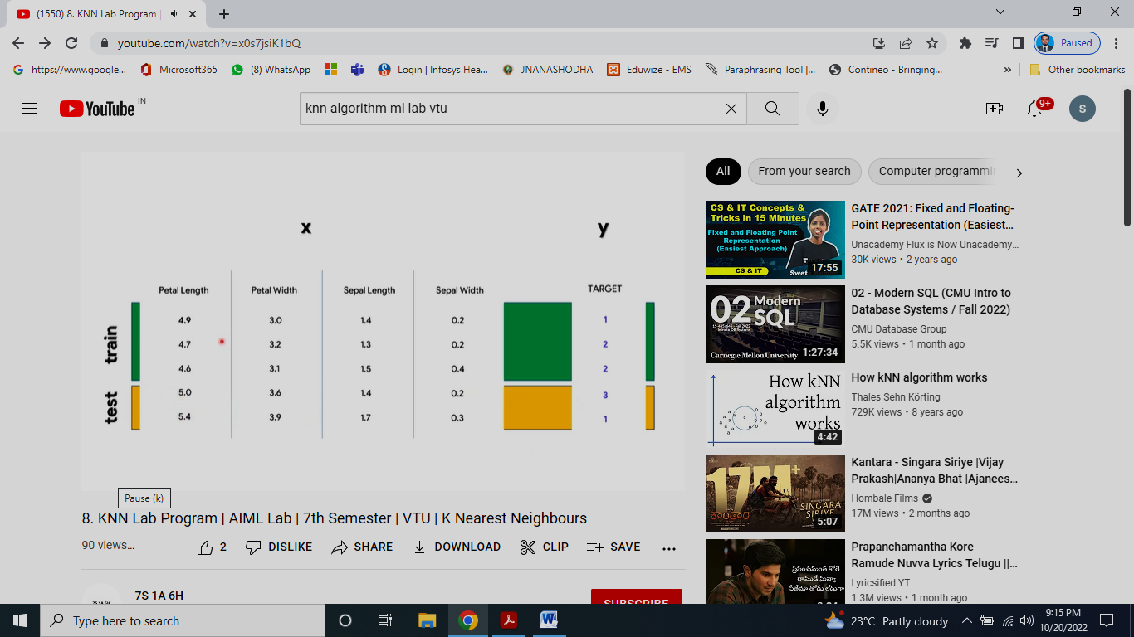
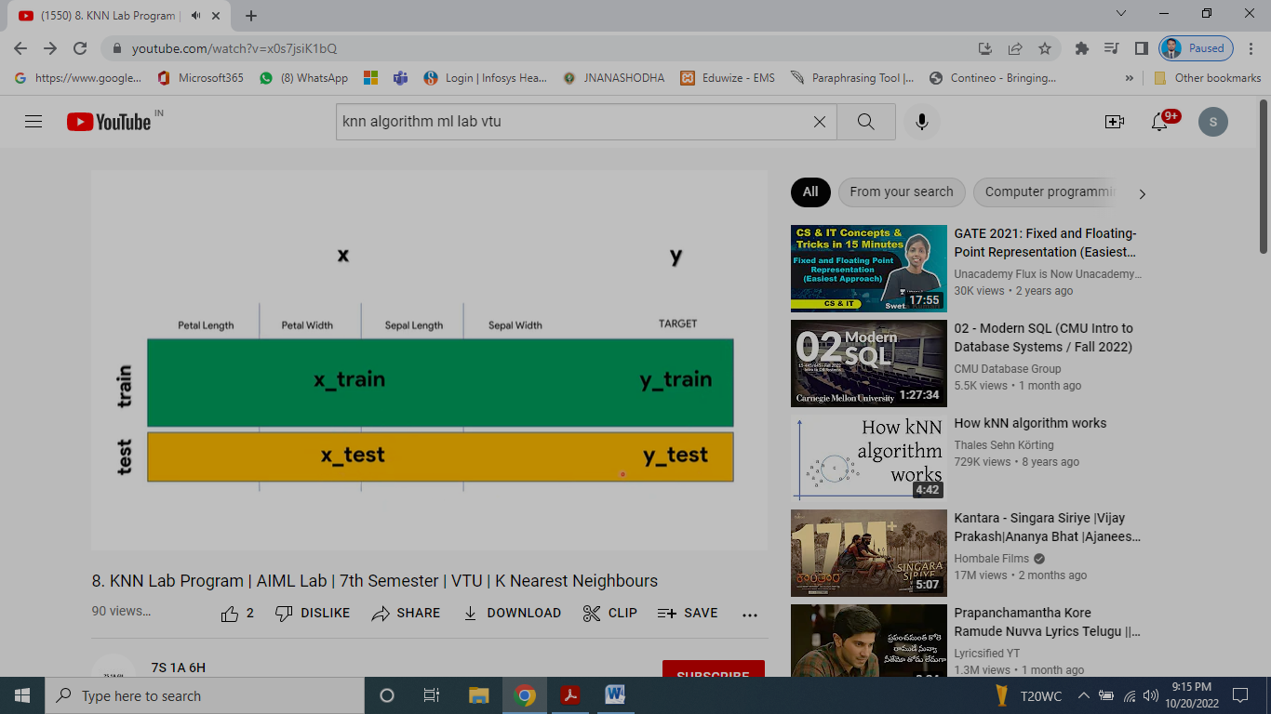
Thus we come up with four parts of data sets x_train, y_train, x_test, y_test

Slide 12
from sklearn.datasets import load_iris
iris=load_iris()
Iris dataset is imported using load_iris() from scikit-learn
-well-known dataset in machine learning.
-contains data for three different species of iris flowers
(Setosa, Versicolor, and Virginica).
-Features (Attributes): Sepal length, Sepal width
Petal length, Petal width
-Target Labels:
These represent the species of iris flowers, and there are three classes:
0: Iris Setosa
1: Iris Versicolor
2: Iris Virginica

Slide 13
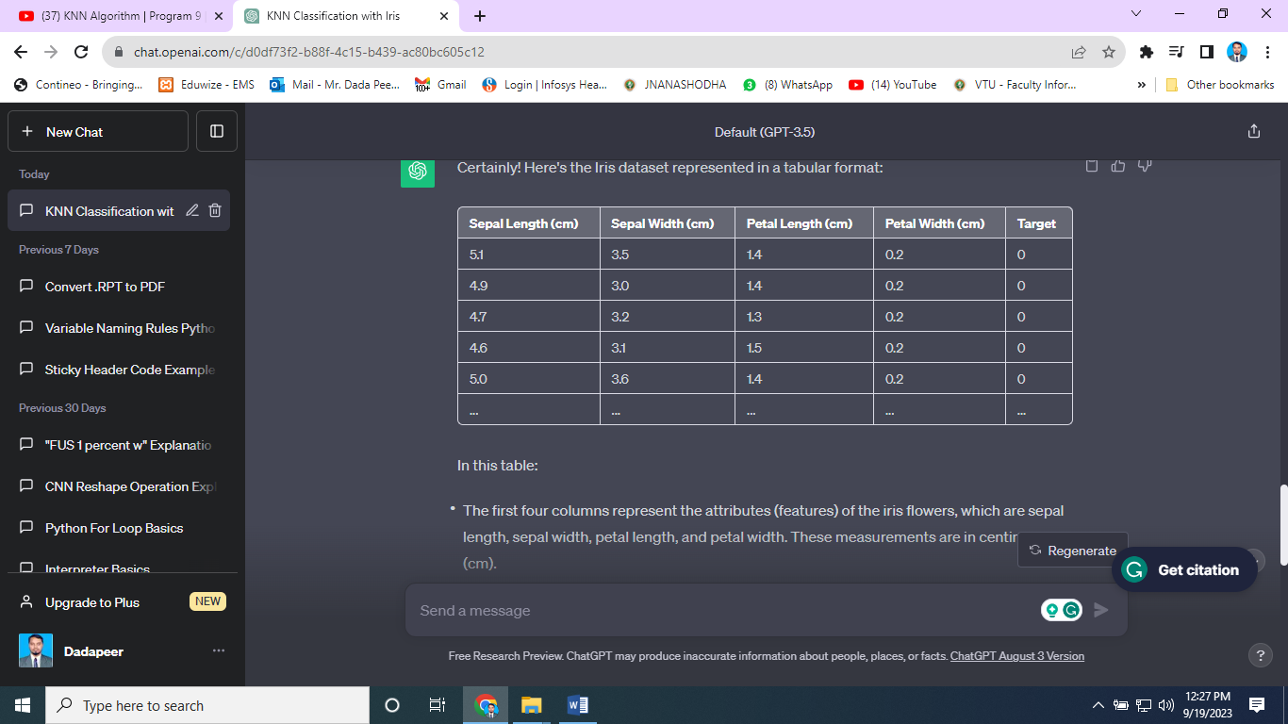

Slide 14
x=iris.data
y=iris.target
Split the dataset into features (x) and target labels (y)
-iris.data contains all the feature values (sepal length, sepal width, petal length, and petal width) for all the samples in the dataset. returns the feature data as a NumPy array, including all four columns.
The target attribute contains the target labels (species information).

Slide 15
print(x[:5],y[:5])
prints the first 5 rows of the feature data (x) and the corresponding target labels (y) from the Iris dataset.
Output
[[5.1 3.5 1.4 0.2]
[4.9 3. 1.4 0.2]
[4.7 3.2 1.3 0.2]
[4.6 3.1 1.5 0.2]
[5. 3.6 1.4 0.2]] [0 0 0 0 0]

Slide 16
from sklearn.model_selection import train_test_split
xtrain,xtest,ytrain,ytest =train_test_split(x,y,test_size=0.4,random_state=1)
Split the data into training and testing sets

Slide 17
from sklearn.model_selection import train_test_split
imports the train_test_split function from scikit-learn's model_selection module which splits dataset into training and testing subsets.
xtrain,xtest,ytrain,ytest =train_test_split(x,y,test_size=0.4,random_state=1)
This actually performs the split
x-feature data and y- target labels from your dataset, which you loaded earlier using load_iris().
test_size=0.4 specifies that 40% of the data will be used for testing, and the remaining 60% will be used for training.
random_state=1: sets the random seed for the random number generator used during the split which ensures that the split is reproducible. If you use the same seed value in the future, you will get the same split. It's useful for debugging and making your results reproducible.
xtrain, xtest, ytrain, ytest variables store the resulting training and testing data.

Slide 18
print(iris.data.shape)
print(len(xtrain))
print(len(ytest))
Print the shape of the Iris dataset and the lengths of the training and testing sets
print(iris.data.shape): This line prints the shape of the Iris dataset.
[
iris.data is a NumPy array containing the feature data, and
iris.data.shape returns a tuple representing the dimensions of the array. It prints two values
-The first value is the number of rows (samples) in the dataset.
-The second value is the number of columns (features) in the dataset, which is 4 since there are four attributes (sepal length, sepal width, petal length, and petal width).
OUTPUT
(150, 4)

Slide 19
print(len(xtrain)): Prints the number of samples (rows) in the training set, which is stored in the variable xtrain, which is the size of the training data.
OUTPUT
90
print(len(ytest)): Prints the number of samples (rows) in the testing set, which is stored in the variable ytest, which is size of the testing data.
OUTPUT
60

Slide 20
from sklearn.neighbors import KNeighborsClassifier
knn=KNeighborsClassifier(n_neighbors=1)
Creates a KNN classifier with n_neighbors=1
from sklearn.neighbors import KNeighborsClassifier,
This line imports the KNeighborsClassifier class from scikit-learn's neighbors module.
The KNeighborsClassifier is a supervised machine learning algorithm used for classification tasks.
knn = KNeighborsClassifier(n_neighbors=1)
This line creates an instance of the KNeighborsClassifier class with a parameter n_neighbors set to 1, which specifies that the classifier should consider only the closest single neighbor when making predictions.

Slide 21
knn.fit(xtrain,ytrain)
Train the KNN classifier on the training data
knn is KNN classifier instance created earlier
fit(xtrain, ytrain): method used to train the KNN classifier on your training data.
xtrain: This parameter represents the feature data from your training set.
ytrain: This parameter represents the target labels associated with your training data.

Slide 22
pred=knn.predict(xtest))
Make predictions on the test data
knn is KNN classifier instance created earlier
predict(xtest): This method makes the prediction on a set of data using the trained model
xtest: This parameter represents the feature data from your testing set.
The result of this variable pred, is an array of predicted class labels.

Slide 23
from sklearn import metrics
print("Accuracy",metrics.accuracy_score(ytest,pred))
print(iris.target_names[2])
ytestn=[iris.target_names[i] for i in ytest]
predn=[iris.target_names[i] for i in pred]
print("predicted Actual")
Evaluating the Performance
from sklearn import metrics- This line imports the metrics module from scikit-learn, which contains various functions for evaluating machine learning model performance.
print("Accuracy", metrics.accuracy_score(ytest, pred)) –
This line calculates and prints the accuracy of your KNN classifier's predictions on the testing data.
ytest: parameter represents the actual target labels for the testing data (true values).
pred: parameter represents the predicted class labels made by your KNN classifier for the testing data.

Slide 24
Output
Accuracy 0.9666666666666667
print(iris.target_names[2])-This line prints the name of the iris species associated with the target label value 2.
Output
virginica

Slide 25
ytestn=[iris.target_names[i] for i in ytest]
predn=[iris.target_names[i] for i in pred]
print("predicted Actual")
Evaluating the Performance
ytestn = [iris.target_names[i] for i in ytest] and
predn = [iris.target_names[i] for i in pred]:
These lines create two new lists, ytestn and predn, by mapping the integer target labels in ytest and pred to their corresponding iris species names using iris.target_names.
These lists will contain the names of the actual and predicted iris species, respectively.
print("predicted Actual"): This line prints the headers "predicted" and "Actual" to label the output that will follow.
Top of Form
Output:
predicted Actual

Slide 26
for i in range(len(pred)):
print(i," ",predn[i]," ",ytestn[i])
Evaluating the Performance
This loop that iterates through the predictions (predn) and the actual target labels (ytestn) for the testing data.
It prints the index (i), the predicted species (predn[i]), and the actual species (ytestn[i]) for each data point.
Output:
1 versicolor versicolor 2 versicolor versicolor 3 setosa setosa 4 virginica virginica 5 virginica versicolor 6 virginica virginica 7 setosa setosa 8 setosa setosa 9 virginica virginica 10 versicolor versicolor 11 setosa setosa 12 virginica virginica 13 versicolor versicolor 14 versicolor versicolor 15 setosa setosa | 16 versicolor versicolor 17 versicolor versicolor 18 setosa setosa 19 setosa setosa 20 versicolor versicolor 21 versicolor versicolor 22 versicolor versicolor 23 setosa setosa 24 virginica virginica 25 versicolor versicolor 26 setosa setosa setosa setosa 28 versicolor versicolor 29 virginica virginica 30 versicolor versicolor | 31 virginica virginica 32 versicolor versicolor 33 virginica virginica 34 virginica virginica 35 setosa setosa 36 versicolor versicolor 37 setosa setosa 38 versicolor versicolor 39 virginica virginica 40 virginica virginica 41 setosa setosa 42 versicolor virginica 43 virginica virginica 44 versicolor versicolor 45 virginica virginica
46 setosa setosa 47 setosa setosa 48 setosa setosa 49 versicolor versicolor 50 setosa setosa 51 setosa setosa 52 virginica virginica 53 virginica virginica 54 virginica virginica 55 virginica virginica 56 virginica virginica 57 versicolor versicolor 58 virginica virginica 59 versicolor versicolor

